Slide 1


Adult Census Income Prediction
Lachandra Ash
DSC680
10/20/2022

Slide 2
Purpose
The adult census income prediction goal was created to determine if an individual earned less than, equal to, or greater than $50K per year.
The target variable is the income attribute.
I utilized the Naïve Bayes algorithm to predict the income.

Slide 3
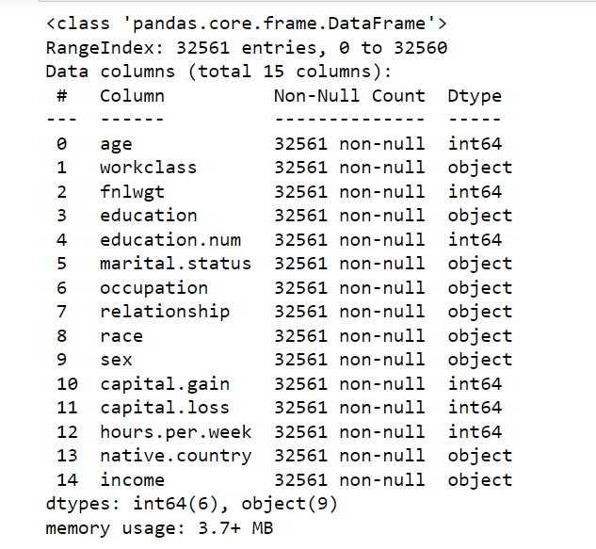
The Adult Census Income Prediction Dataset Info

Slide 4
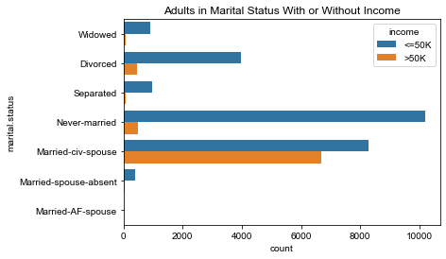
The Marital Status and Income Countplot
The married-civ-spouse category had the highest number of adults with income that is lower or equal to $50K per year.
The married-civ-spouse category had the highest number of adults with incomes that was greater than $50K per year.
The divorced adults had more adults earning income less than or equal to $50K per year versus divorced adults who earned more income than $50K per year.

Slide 5
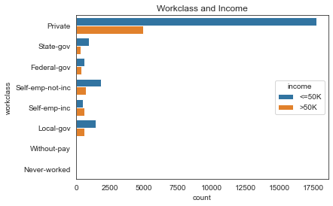
The Private Workclass
The private category has the highest number of adults who earned income that was greater than $50k per year.
The private category has the highest number of adults who earned income that was less than or equal to $50K per year.

Slide 6
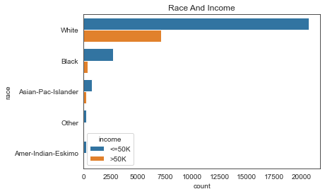
RAce and Income Countplot
The white category had the highest number of adults who earned income that was less than, equal to, and greater than $50K per year.
The black category had the second highest number of adults who earned income that was less than, equal to, and greater than $50K per year.

Slide 7
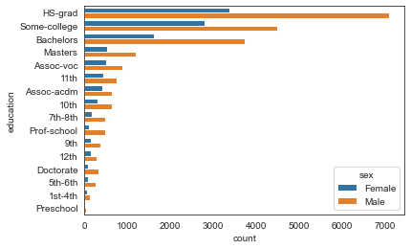
The Education and Sex Countplot
There is a higher count of males within each education category versus the females.
More males than females will most likely attend post-high school education and obtain a Bachelor’s degree, Master’s degree, or a Doctorate.

Slide 8
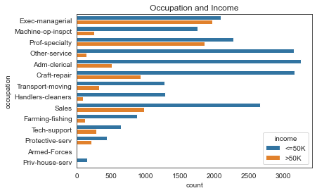
The Occupation and Income Countplot
The exec-managerial, prof-specialty, craft-repair, sales, are the top occupations with the highest number of adults who earned income that is less than, greater than, or equal to $50K per year.
The adults who worked in the armed-forces did not earn income.
Overall, there are more adults who earn income that is less than or equal to $50k per year versus adults earning income that is greater than $50K.

Slide 9
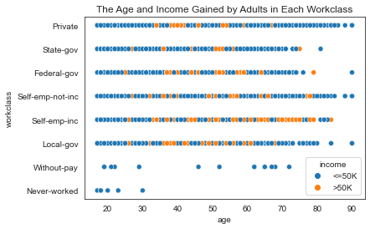
The Age and Income Gained by Adults in Each Workclass Scatterplot
Each adult in every occupation earned data that was less than or equal to $50K per year.
The adults within the without-pay and never-worked occupations did not earn income greater than $50K per year.

Slide 10
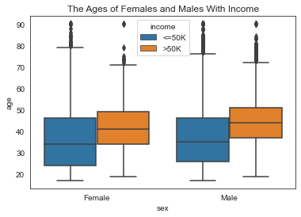
The Ages of Females and Males with Income
The males gained more income than the females.
There are more males who earned income that is greater than $50K per year.
There are more males who earned income that was less than or equal to $50K per year.

Slide 11
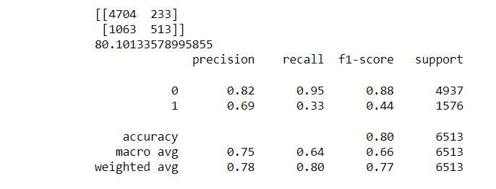
The Model
The train, test, and split methods were used to create and fit the Gaussian Naïve Bayes model.
The confusion matrix, accuracy score, and classification report were used for the prediction test.
The accuracy score for the adult income prediction was 80.1%.

Slide 12
Conclusion
The Naive Bayes Predictor's classifier method gave strong results.
Very minimal adjustment needed to be made to the model's hyperparameters.
The minimal adjustments are one of the method's greatest assets.
The model can be improved overtime by retesting it for better prediction accuracy.
Possibly, rebalancing the dataframe can help improve the accuracy score.

